Slide 1

APEX INSTITUTE OF TECHNOLOGY
DEPARTMENT OF COMPUTER SCIENCE & ENGINEERING
Computer Organization & Architecture (21CSH-281)
Faculty: Siddharth Kumar (E12853)
Lecture – 21
Memory System Design: Memory Organization
DISCOVER . LEARN . EMPOWER

Slide 2
Computer Organization & Architecture: Course Objectives
COURSE OBJECTIVES
The course aims to:
The purpose of the course is to introduce principles of computer organization and the basic architectural concepts.
It begins with basic organization, design, and programming of a simple digital computer and introduces simple register transfer language to specify various computer operations.
Topics include computer arithmetic, instruction set design, microprogrammed control unit, pipelining and vector processing, memory organization and I/O systems, and multiprocessors.
To familiarize Students with the detailed Architectures of a Central Processing Unit.
Learn the different types of serial communication techniques.

Slide 3
COURSE OUTCOMES
On completion of this course, the students shall be able to:-
CO1 | Identify and interpret the basics of instruction sets and their impact on the design, organization, and functionality of various functional units of a computer comparable to the CPU, memory organization, I/O organization, and parallel processors.
CO2 | Analysis of the design of arithmetic & logic unit and understanding of the fixed point and floating-point arithmetic operations.
CO3 | Relate cost performance and design trade-offs in designing and constructing a computer processor which includes memory.
CO4 | Understanding the different ways of communicating with I/O devices and standard I/O interfaces.
CO5 | Implementation of control unit techniques and the concept of Pipelining.

Slide 4
Classification of Memory
In computers, memory is the most essential component of the normal functioning of any system. The computer system categorizes the memory for different purposes and uses. In this slide, we have discussed the classification of memory in detail. Also, we will discuss types of memory, features of memory, RAM, ROM, SRAM, DRAM, and its advantages and disadvantages.
What is computer memory?
Computer memory is any physical device, used to store data, information or instruction temporarily or permanently.
It is the collection of storage units that stores binary information in the form of bits. The memory block is split into a small number of components, called cells.
Each cell has a unique address to store the data in memory, ranging from zero to memory size minus one.
For example, if the size of computer memory is 64k words, the memory units have 64 * 1024 = 65536 locations or cells. The address of the memory's cells varies from 0 to 65535.

Slide 5
Memory Hierarchy
Memory is used for storing programs and data that are required to perform a specific task.
For CPU to operate at its maximum speed, it required an uninterrupted and high speed access to these memories that contain programs and data. Some of the criteria need to be taken into consideration while deciding which memory is to be used:
Cost
Speed
Memory access time
Data transfer rate
Reliability

Slide 6
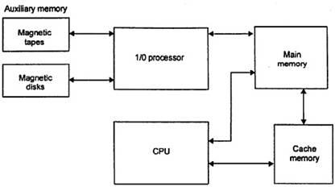
How Memories attached to CPU
Img source: https://homepage.cs.uri.edu/faculty/wolfe/book/images/R04/mb.gif

Slide 7
A computer system contains various types of memories like auxiliary memory,
cache memory, and main memory.
Auxiliary Memory
The auxiliary memory is at the bottom and is not connected with the CPU directly. However, being slow, it is present in large volume in the system due to its low pricing. This memory is basically used for storing the programs that are not needed in the main memory. This helps in freeing the main memory which can be utilized by other programs that needs main memory. The main function of this memory is to provide parallel searching that can be used for performing a search on an entire word.
Main Memory
The main memory is at the second level of the hierarchy. Due to its direct connection with the CPU, it is also known as central memory. The main memory holds the data and the programs that are needed by the CPU. The main memory mainly consists of RAM, which is available in static and dynamic mode.
Cache Memory
Cache memory is at the top level of the memory hierarchy. This is a high speed memory used to increase the speed of processing by making current programs and data available to the CPU at a rapid rate. Cache memory is usually placed between the CPU and the main memory.

Slide 8
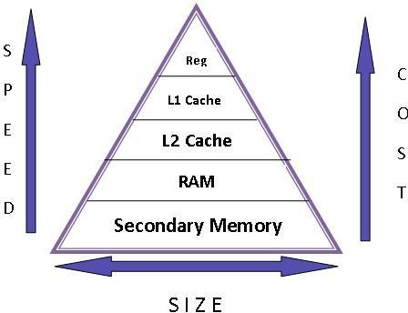
Img source: https://homepage.cs.uri.edu/faculty/wolfe/book/images/R04/mb.gif

Slide 9
Main Memory
Central storage unit in a computer system
Large memory
Made up of Integrated chips
Types:
RAM (Random access memory) ROM (Read only memory)

Slide 10
RAM (Random Access Memory)
Random access memory (RAM) is the best known form of computer memory. RAM is considered "random access" because you can access any memory cell directly if you know the row and column that intersect at that cell.
Types of RAM:-
Static RAM (SRAM)
Dynamic RAM (DRAM)

Slide 11
Static RAM (SRAM)
a bit of data is stored using the state of a flip-flop.
Retains value indefinitely, as long as it is kept powered.
Mostly uses to create cache memory of CPU.
Faster and more expensive than DRAM.
Dynamic RAM (DRAM)
Each cell stores bit with a capacitor and transistor.
Large storage capacity
Needs to be refreshed frequently.
Used to create main memory.
Slower and cheaper than SRAM.

Slide 12
ROM
ROM is used for storing programs that are Permanently resident in the computer and for tables of constants that do not change in value once the production of the computer is completed
The ROM portion of main memory is needed for storing an initial program called bootstrap loader, witch is to start the computer software operating when power is turned on.
There are five basic ROM types:
ROM - Read Only Memory
PROM - Programmable Read Only Memory
EPROM - Erasable Programmable Read Only Memory
EEPROM - Electrically Erasable Programmable Read Only Memory
Flash EEPROM memory

Slide 13
RAM and ROM Chips
A RAM chip is better suited for communication with the CPU if it has one or more control inputs that select the chip when needed
The Block diagram of a RAM chip is shown next slide, the capacity of the memory is 128 words of 8 bits (one byte) per word

Slide 14
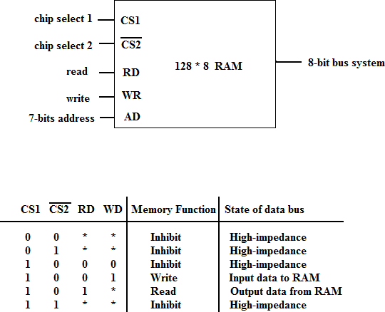
RAM
Img source: https://homepage.cs.uri.edu/faculty/wolfe/book/images/R04/mb.png

Slide 15
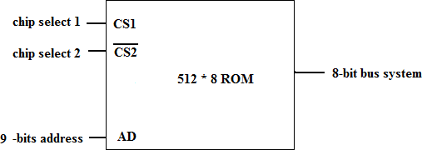
ROM
Img source: https://homepage.cs.uri.edu/faculty/wolfe/book/images/R04/m.png

Slide 16
Memory Address Map
Memory Address Map is a pictorial representation of assigned address space for each chip in the system
To demonstrate an example, assume that a computer system needs 512 bytes of RAM and 512 bytes of ROM
The RAM have 128 byte and need seven address lines, where the ROM have 512 bytes and need 9 address lines

Slide 17
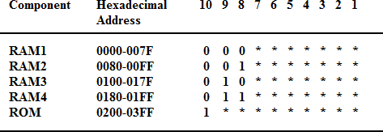

Slide 18
The hexadecimal address assigns a range of hexadecimal equivalent address for each chip
Line 8 and 9 represent four distinct binary combination to specify which RAM we chose
When line 10 is 0, CPU selects a RAM. And when it’s 1, it selects the ROM

Slide 19
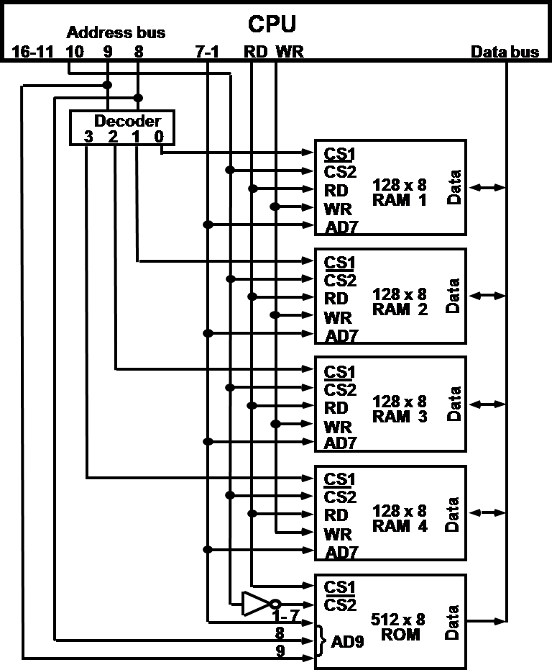
Memory connection to the CPU
Source: http://cms.gcg11.ac.in/attachments/article/93/Memory%20Organization.pdf

Slide 20
Cache memory
If the active portions of the program and data are placed in a fast small memory, the average memory access time can be reduced
Thus reducing the total execution time of the program
Such a fast small memory is referred to as cache memory
The cache is the fastest component in the memory hierarchy and approaches the speed of CPU component

Slide 21
When CPU needs to access memory, the cache is examined
If the word is found in the cache, it is read from the fast memory
If the word addressed by the CPU is not found in the cache, the main memory is accessed to read the word

Slide 22
When the CPU refers to memory and finds the word in cache, it is said to produce a hit
Otherwise, it is a miss
The performance of cache memory is frequently measured in terms of a quantity called hit ratio
Hit ratio = hit / (hit+miss)

Slide 23
The basic characteristic of cache memory is its fast access time
Therefore, very little or no time must be wasted when searching the words in the cache
The transformation of data from main memory to cache memory is referred to as a mapping process, there are three types of mapping:
Associative mapping
Direct mapping
Set-associative mapping

Slide 24
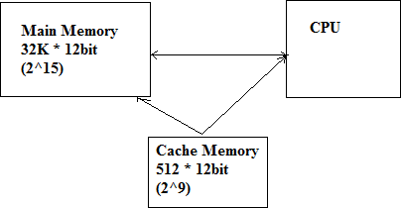
To help understand the mapping procedure, we have the following example:
Source: http://cms.gcg11.ac.in/attachments/article/93/Memory%20Organization.pdf

Slide 25
Associative mapping
The fastest and most flexible cache organization uses an associative memory
The associative memory stores both the address and data of the memory word
This permits any location in cache to store ant word from main memory
The address value of 15 bits is shown as a five- digit octal number and its corresponding 12- bit word is shown as a four-digit octal number

Slide 26
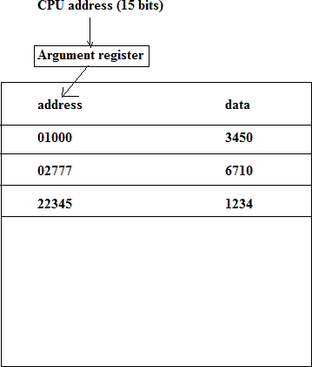
Source: http://cms.gcg11.ac.in/attachments/article/93/Memory%20Organization.pdf

Slide 27
A CPU address of 15 bits is places in the argument register and the associative memory us searched for a matching address
If the address is found, the corresponding 12- bits data is read and sent to the CPU
If not, the main memory is accessed for the word
If the cache is full, an address-data pair must be displaced to make room for a pair that is needed and not presently in the cache

Slide 28
Direct Mapping
Associative memory is expensive compared to RAM
In general case, there are 2^k words in cache memory and 2^n words in main memory (in our case, k=9, n=15)
The n bit memory address is divided into two fields: k-bits for the index and n-k bits for the tag field

Slide 29
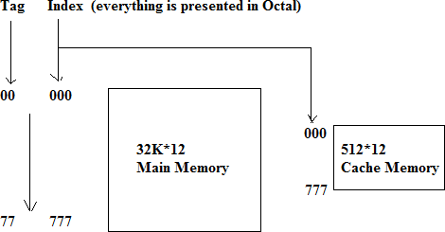
Addressing relationships between main and cache memories
Source: http://cms.gcg11.ac.in/attachments/article/93/Memory%20Organization.pdf

Slide 30
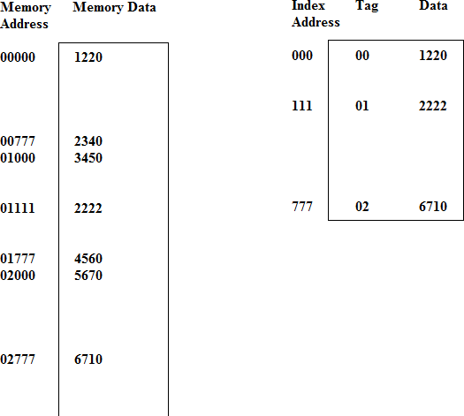
Source: http://cms.gcg11.ac.in/attachments/article/93/Memory%20Organization.pdf

Slide 31
Set-Associative Mapping
The disadvantage of direct mapping is that two words with the same index in their address but with different tag values cannot reside in cache memory at the same time
Set-Associative Mapping is an improvement over the direct-mapping in that each word of cache can store two or more word of memory under the same index address

Slide 32
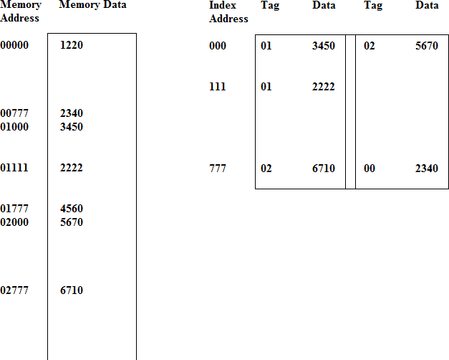
Source: http://cms.gcg11.ac.in/attachments/article/93/Memory%20Organization.pdf

Slide 33
Each index address refers to two data words and their associated tags
Each tag requires six bits and each data word has 12 bits, so the word length is 2*(6+12) = 36 bits

Slide 34
Key Points
Memory organization
Memory Hierarchy
RAM
ROM
Cache memory
Types of mapping

Slide 35
Summary
Discussed about Memory organization.
Discussed about Memory Hierarchy.
Discussed about RAM and ROM.
Discussed about the Cache memory
Assessment Questions
Q1. What is computer memory?
Q2. Discussed the Classification of Memory.

Slide 36
THANK YOU

